Slide 1
Pathogenic bacteria.
Dr.Munira Ch. Ismail Lec.5

Slide 2
GRAM POSITIVE NON-SPORE FORMING RODS.
GENUS CORYNEBACTERIA.
Medical important species: Corynebacteria diphteriae
C. diphteriae.
Characteristics:
Non-spore forming, non-capsulated, non-motile aerobe or facultative
anaerobe gram-positive rods.
Possess irregular swelling at one end that give them the “clubshaped”
appearance.

Slide 3
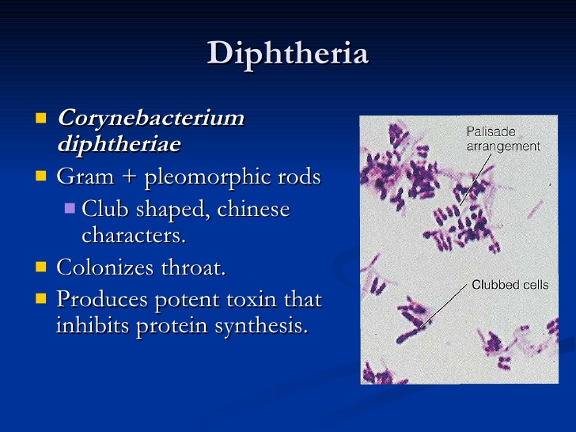

Slide 4
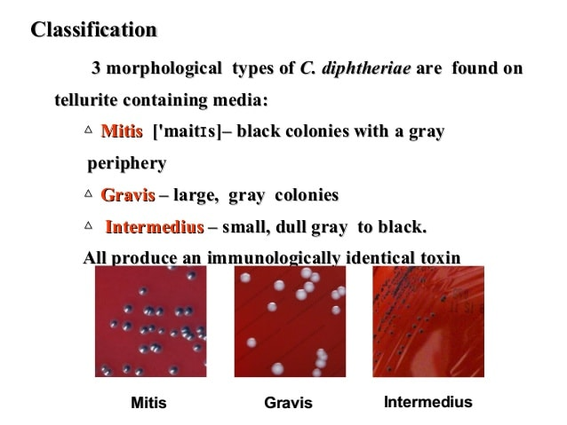

Slide 5
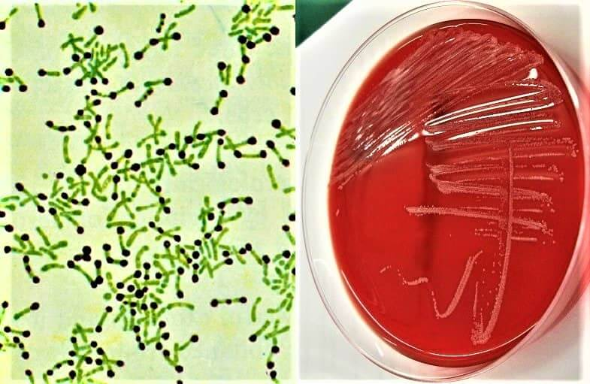
Possess granules (metachromatic granules) near the poles that give
the rod a beaded appearance
It tends to lie in parallel (pallisades) or at acute angles to one
another in stained smears, forming V,L , W shapes, so called
Chinese-character arrangement.

Slide 6
Pathogenesis and clinical features:
Diphteria toxin causes respiratory tract epithelial destruction tesulting in formation of necrotic epithelium with pseudomembrane formation over the tonsils, pharynx, and larynx. Distant toxic damage includes parenchymal degeneration and necrosis in heart muscle,liver, kidney, adrenal glands and peripheral and cranial nerves.
Wound/skin diphteria occurs chiefly in the tropics and forms
membrane-covered wound that fails to heal. Systemic effect is
negligible.
It clinically manifests with fever, sorethroat, suffocation (due to obstruction by upper respiratory tract pseudomembrane formation),arrhythemia, and difficulty of vision, swallowing and paralysis of upper and lower extremities.
NB: C.diphteriae var gravis tends to produce more severe disease than var mitis.

Slide 7
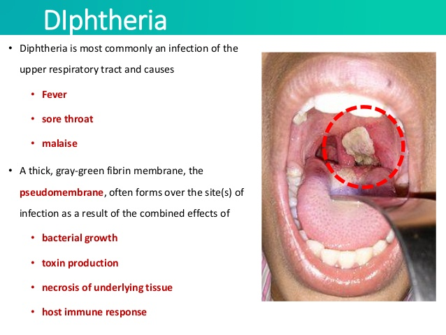

Slide 8
Laboratory diagnosis:
Specimen Swabs from the nose, throat, or suspected lesion.
Smears: Beaded rods in typical arrangement when stained with alkaline methylene blue or gram’s stain.
Culture: Small, granular,and gray, with irregular edges with small
zone of hemolysis on blood agar.
Selective media are necessary for isolation from cilincal specimens
Selective media.
1. Loeffler’s serum media: Grows rapidly with in 8 hrs. after inoculation and show typical appearance.
2. Blood tellurite agar: Produce characteristic grey-black colonies due to their ability to reduce potassium tellurite totellurium.

Slide 9
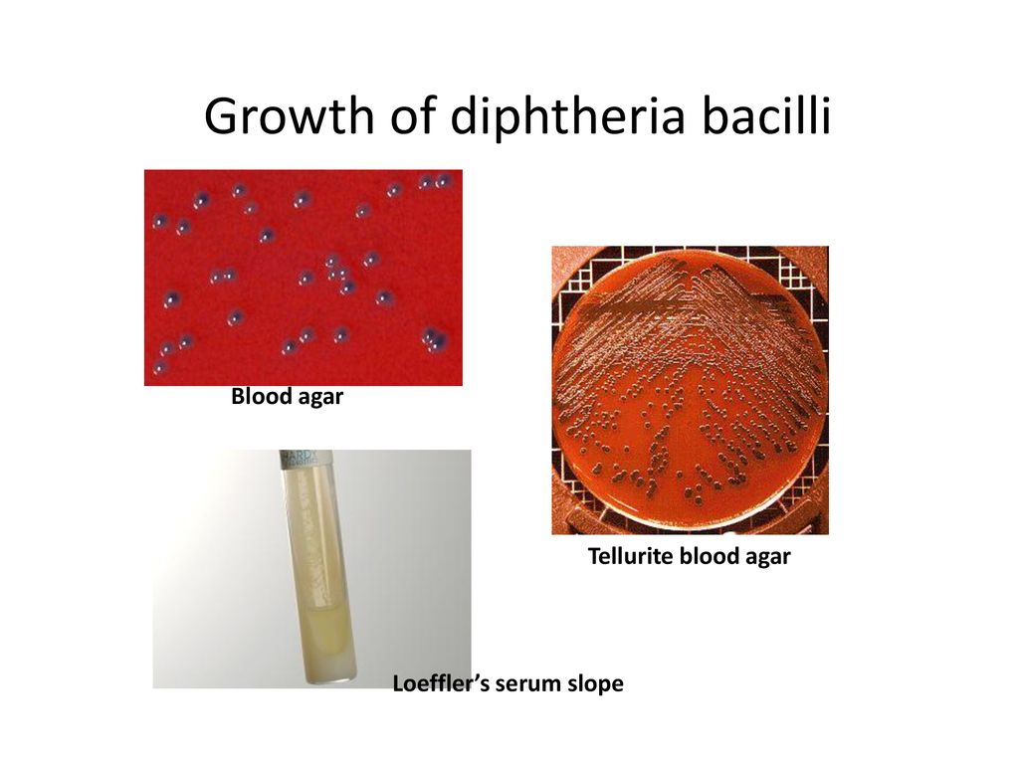

Slide 10
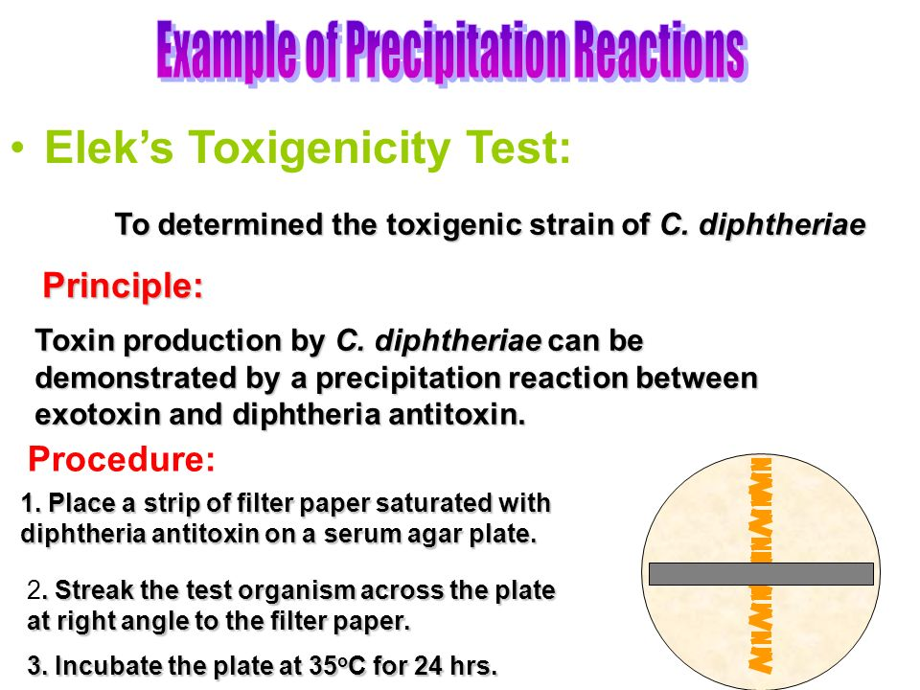

Slide 11
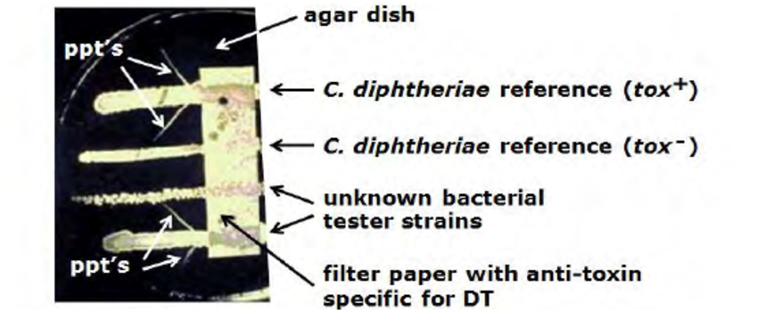
Gel-precipitation (Elek) test.

Slide 12
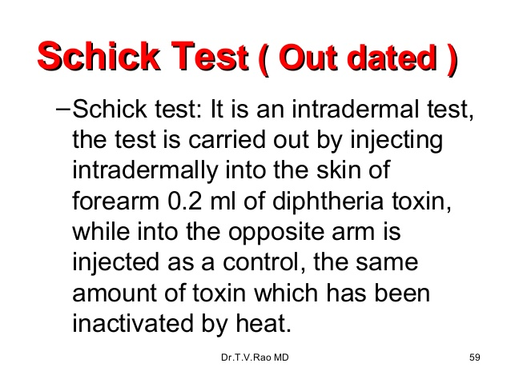
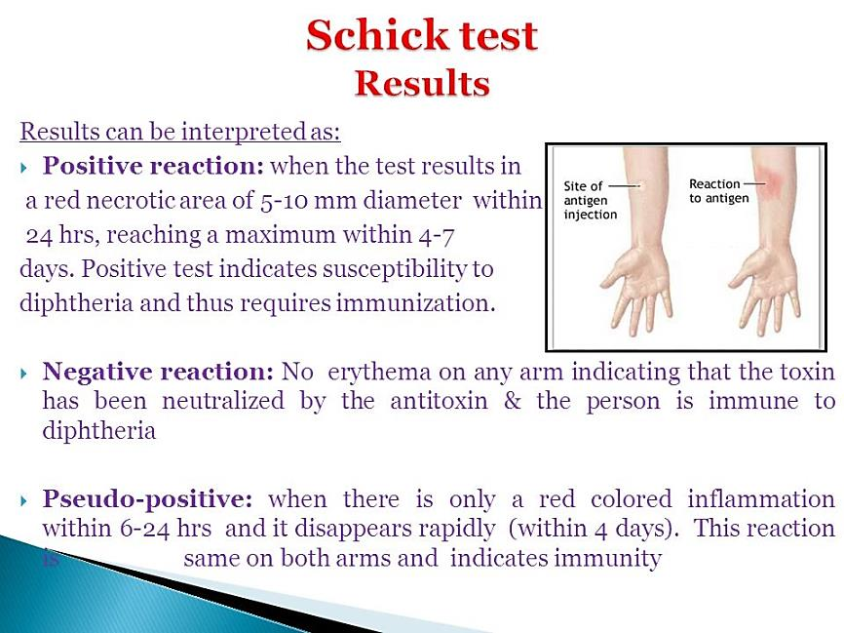

Slide 13
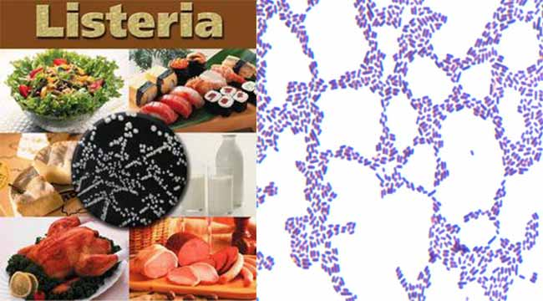
GENUS: LISTERIA:
Most important species: Listeria monocytogenes.
L. monocytogens.
General characteristics:
. Widely present in plants, soil and surface water.
. Zoonotic pathogen of domestic animals.
. Non-sporulating, facultative anaerobe, intracellular. Gram positive rods.

Slide 14
Pathogenesis and clinical features:
Transmitted to humans through ingestion of poorly cooked meat and unpasteurized milk and milk products.
1. Perinatal human listeriosis: Granulomatous infantisepticum.
. Early onset syndrome: Intrauterine sepsis.
. Late onset syndrome: Neonatal meningitis.
2. Adult human listeriosis.
. Meningoencephalitis.
. Bacteremia.
Lab. Diagnosis:
Specimen: Blood/ CSF.
Culture: Grow in blood agar and demonstrate narrow zone of β-hemolysis.
Produce “umbrella” growth pattern below the motility media surface at room T0, demonstrating motility at room temperature.
Biochemical reaction: Catalase positive ,Oxidase negative.

Slide 15


